Slide 1

Understanding the Behavior of Oil Wells through Deep Learning
TRiCAM QRI Project
Presentation 2
Presenter: Janette Garcia
Project Members: Michelle Yang, Akash Levy, Janette Garcia, Albert Tung

Slide 2
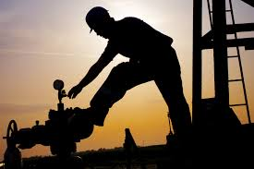
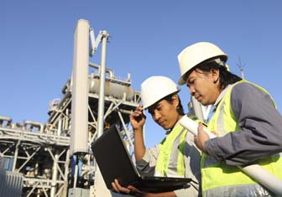
Objectives
Develop a machine learning tool to:
Forecast the expected production trends of a well
Identify historical production events

Slide 3
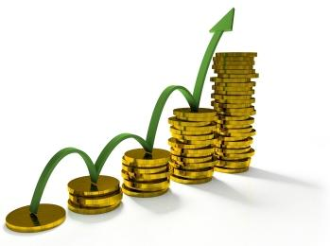
Relevance
Accelerate the speed of oil well profile diagnosis/forecast
Quickly identify the remaining opportunities in the field
Significantly increase the capital efficiency
Minimize the risk of making multibillion-dollar decisions
Improve reservoir management practices for conventional reservoirs
NOTE: There are 1.1 million active wells in the US, which represent less than 10% of the worlds oil production. An improvement in how these wells are analyzed and diagnosed could lead to significant opportunities.

Slide 4
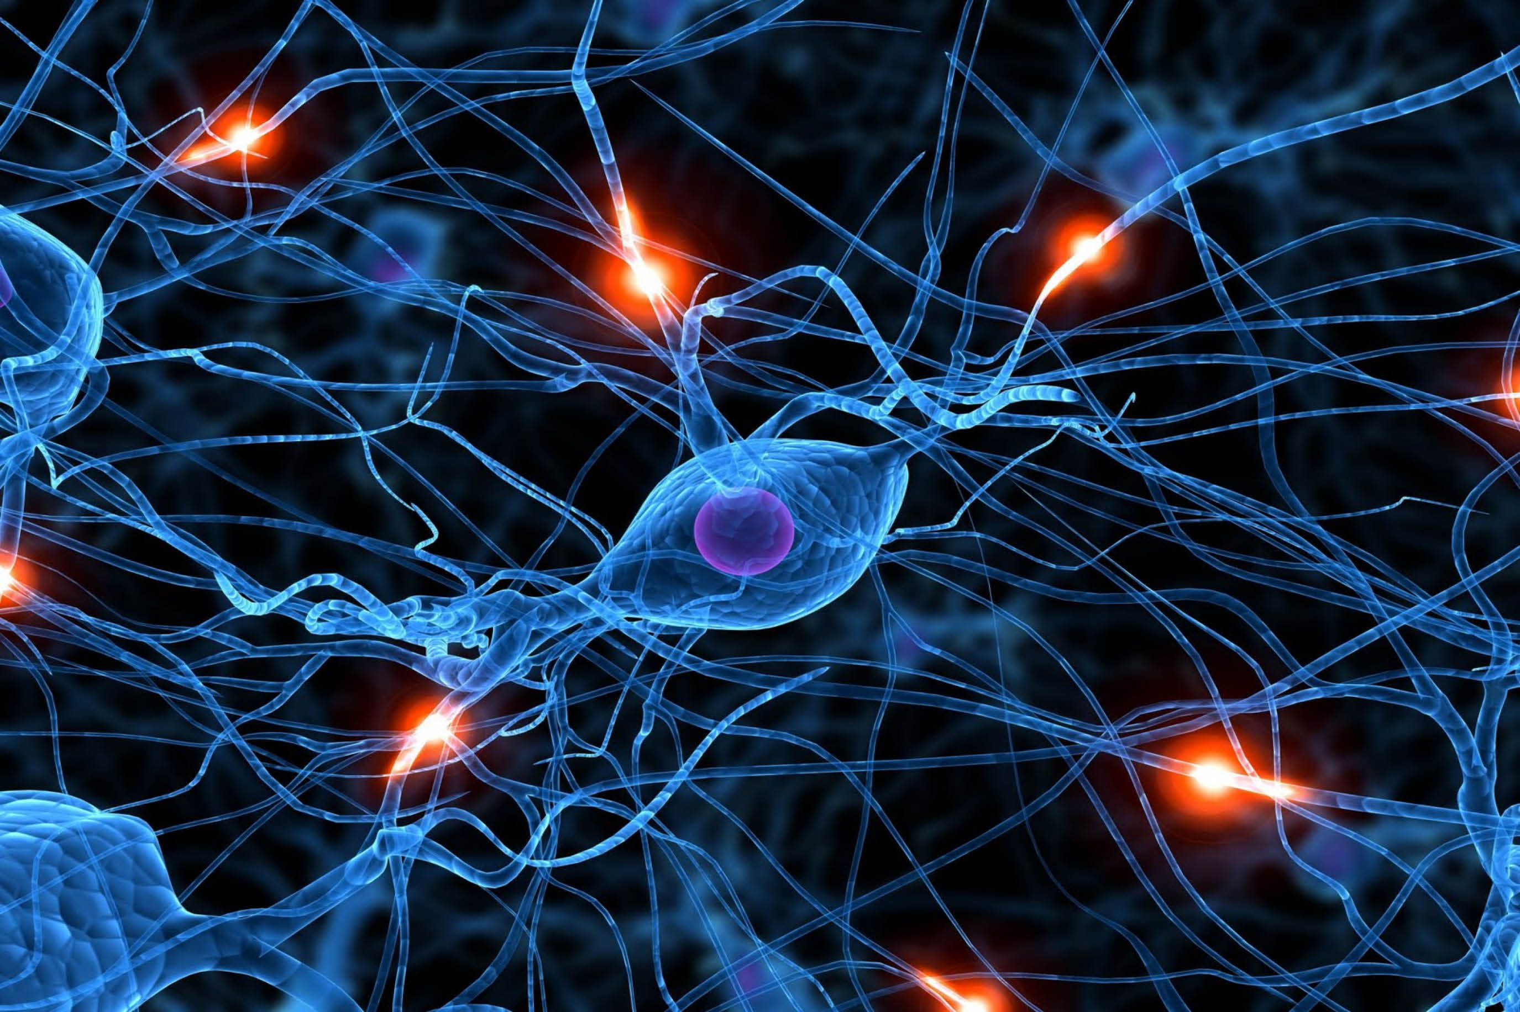
Deep Learning
Branch of machine learning based on a set of algorithms that model a high level abstraction by using model architectures such as:
Recurrent neural network (RNN)
Autoencoder
Convolutional neural network, (CNN)
Restricted Boltzmann Machines (RBM)

Slide 5
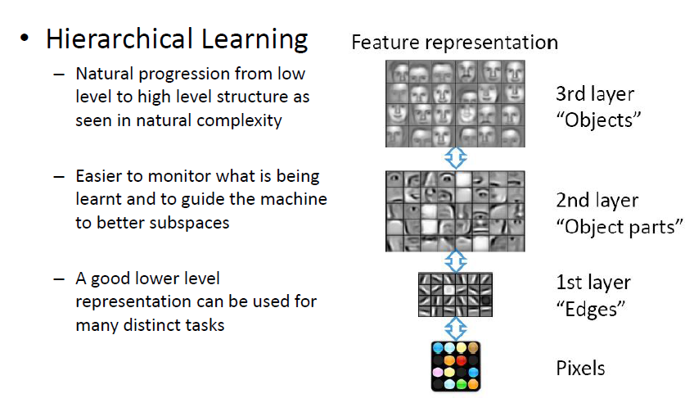
Different Levels of Abstraction

Slide 6



Weekly Goals
Weekly Goals | Akash Convolution Neural Network | Albert Restricted Boltzmann Machines | Janette Autoencoders | Michelle Recurrent Neural Network
June 22, 2015 | Tutorials for Theano, deep learning, looking over deep learning methods (FTML Book, Deep Learning Tutorial: 30 pgs/day) | Complete Tutorials for Theano, deep learning, looking over deep learning methods (FTML Book, Deep Learning Tutorial: 30 pgs) | Complete Tutorials for Theano, deep learning, looking over deep learning methods (FTML Book, Deep Learning Tutorial: 30 pgs) | Tutorials on Theano, deep learning, looking over deep learning methods (FTML Book, Deep Learning Tutorial: 30 pgs/day)
June 29, 2015 | Implementing deep learning with Theano for CNNs | Implement deep learning with Theano for RBMs | Implement deep learning with Theano for autoencoders | Implement deep learning with Theano for RNNs
July 6, 2015 | Optimizing training deep learning for simple CNNs | Optimize training and deep learning for RBMs | Optimize training and deep learning for autoencoders | Optimize training and deep learning for RNNs
July 13, 2015 | Applying deep learning techniques to data provided by QRI and optimizing | Applying deep learning techniques to data provided by QRI and optimizing | Applying deep learning techniques to data provided by QRI and optimizing | Applying deep learning techniques to data provided by QRI and optimizing

Slide 7
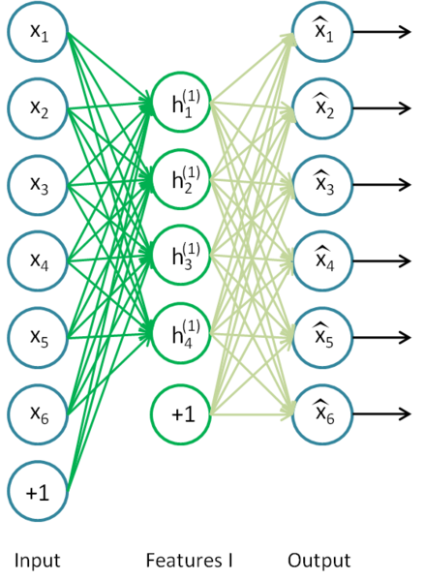
Technique 1: Stacked Autoencoders
Feedforward neural
The outputs of each layer is wired to the inputs of the next layer
Encoder & Decoder
Learn features that form a good representation of its input
Train it with Gradient descent

Slide 8
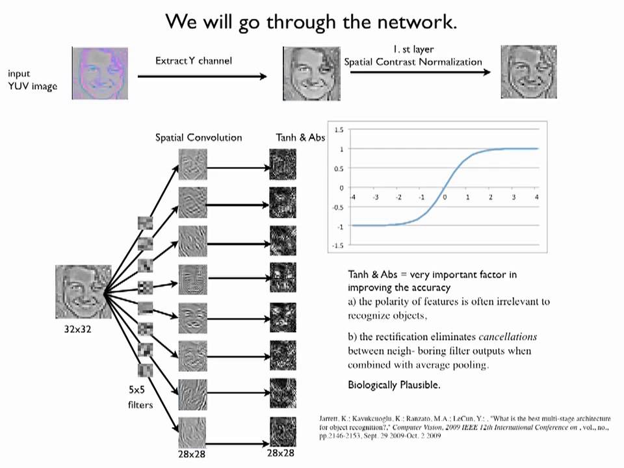
Technique 4: Convolutional Neural Network
Feed forward neural network
Similar to RBM and Autoencoders but instead of learning single global weight matrix between two layers, they aim to find a set of locally connected neurons
Minimal pre-processing
Best at image recognition

Slide 9
Training Neural Network
Shuffle Training data
Partition it into mini-batches
Apply gradient descent for each mini-batch

Slide 10
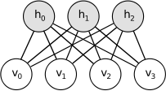
Technique 2: Restricted Boltzmann Machines (RBM)
Not feed forward
Bipartite graph
Generative
Feature-rich and Flexible
Can learn a probability distribution over its set of inputs
Best at dimensionality reduction, feature learning, and topic modelling
Train RBMs with contrastive divergence algorithm

Slide 11
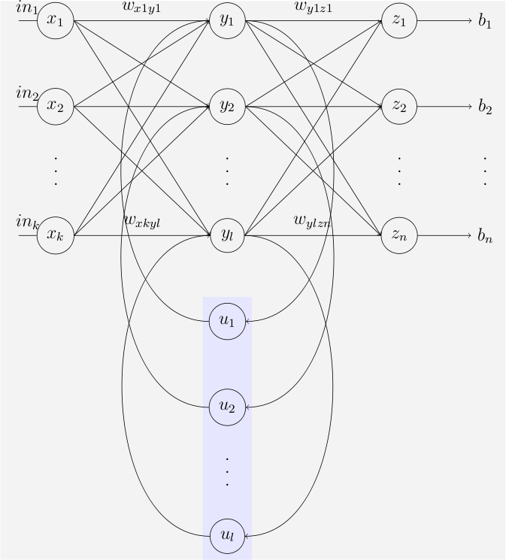
Technique 3: Recurrent Neural Network
Connections between units form a directed cycle
Can use internal memory to process arbitrary sequences of inputs
Training is more difficult
Feedback neural network
Best at unsegmented connected handwriting recognition
0
1
0
0
1
0
0
1
x1
x2

Slide 12
